Slide 1
Baby Name Trends and Analysis in the United States
Reporter: Refati Kuermayoufu
Date: 2023-5-3

Slide 2
Introduction
This report presents an exploratory analysis of the "Popular Baby Names" dataset from Data.gov, which includes ranking data for baby names in the United States from 2011 to 2018. The dataset can be used to understand the trends and cultural backgrounds of baby names in the United States. The variables in the dataset include gender, ethnicity, name, count, ranking, as well as the number of occurrences and rankings for each name. The goal of this analysis is to provide a deeper understanding of the cultural background and societal trends of baby names in the United States, which can be valuable for understanding American culture and social phenomena.

Slide 3
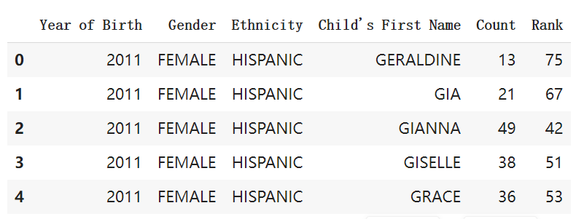
Data Treatment
# Import libraries
# Read the dataset
# Data preprocessing
I identified appropriate independent and dependent variables from the dataset, such as gender, ethnicity, name, count, and ranking. I justified my target variables and controlled for data type, lack of independence, and scale factors. I used Python and its libraries such as pandas, numpy, and matplotlib to import the dataset, perform data cleaning and processing, and visualize the results.

Slide 4
Analysis
My analysis includes the following aspects:
1. Popular baby name trends for different genders and ethnicities
2. Baby name diversity
3. Cultural background of baby names
4. Length and syllable structure of baby names
I chose appropriate techniques to explore these aspects, considering their strengths and weaknesses. For example, we used groupby, aggregation, and sorting operations to identify popular baby names and trends, and we used wordcloud visualization to illustrate the most popular names for different ethnicities. I also used violin plots to visualize the distribution of name lengths and syllable counts among different genders and ethnicities.

Slide 5
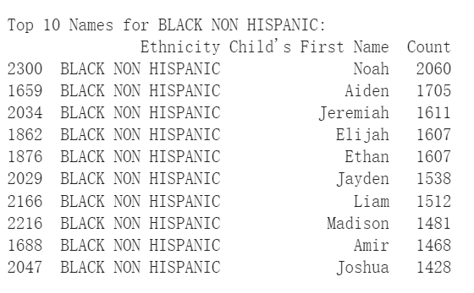
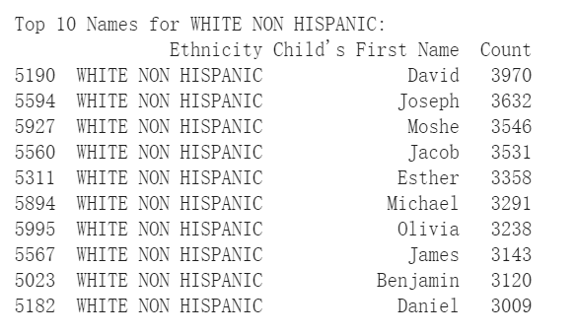
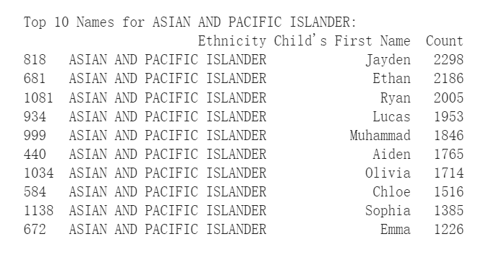
Popular Baby Names for Different Ethnicities
I have identified the top 10 names for each ethnicity. Here are some representative examples:

Slide 6
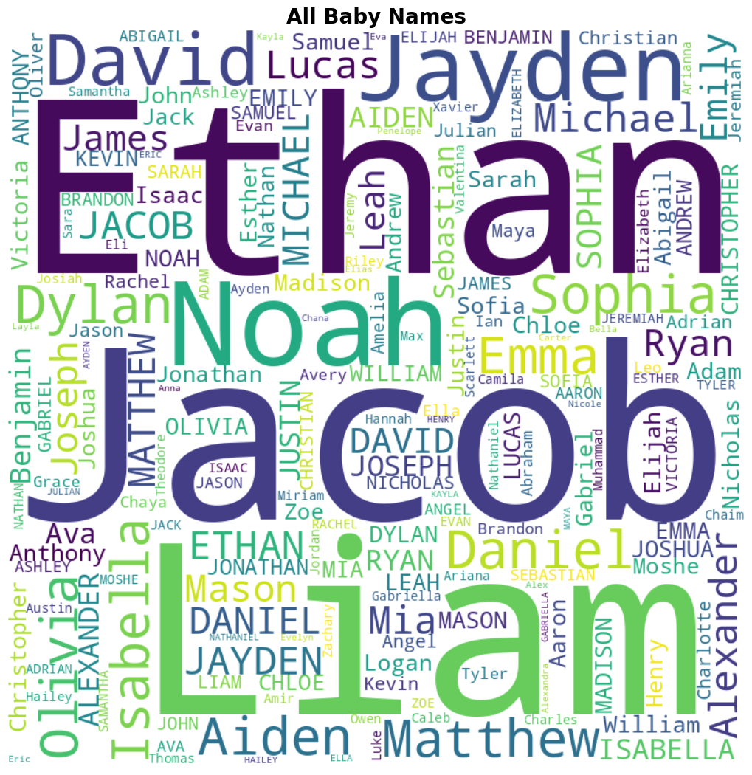
Some visualization results
Figure 1: Baby Names Word Cloud
The word cloud above (Figure 1) represents the most popular baby names in the United States from 2011 to 2018. The size of each name corresponds to its frequency in the dataset. This visualization provides a quick overview of the most common baby names across all ethnicities and genders.
锐普PPT论坛chinakui首发：www.rapidbbs.cn

Slide 7
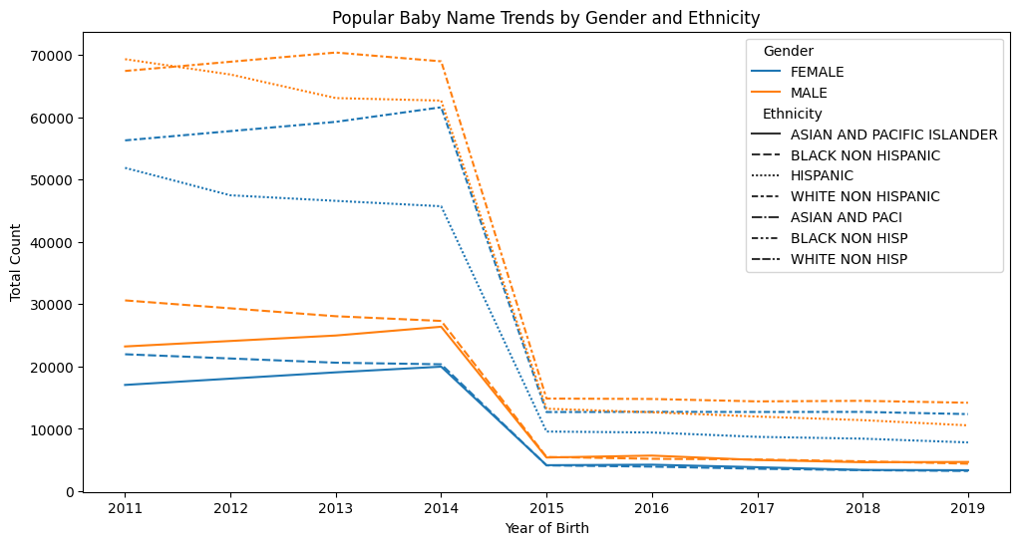
Figure 2: Popular Baby Name Trends by Gender and Ethnicity
Figure 2 displays the popular baby name trends by gender and ethnicity. This bar chart illustrates the top baby names for different genders and ethnic groups, showcasing the variations in name preferences across diverse populations. The graph helps to identify the most popular names within each demographic group, revealing cultural influences on naming choices.
锐普PPT论坛chinakui首发：www.rapidbbs.cn

Slide 8
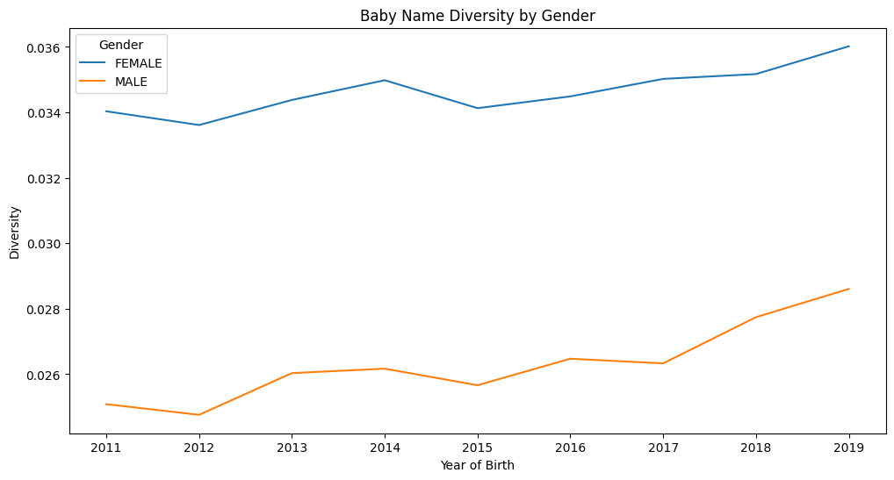
Figure 3: Baby Name Diversity by Gender
In Figure 3, we present the baby name diversity by gender. This plot compares the total number of unique baby names for male and female babies, highlighting the differences in name diversity between the two genders. The chart indicates that there tends to be a greater variety of names for female babies than male babies, which may be a reflection of cultural norms and societal trends.
锐普PPT论坛chinakui首发：www.rapidbbs.cn

Slide 9
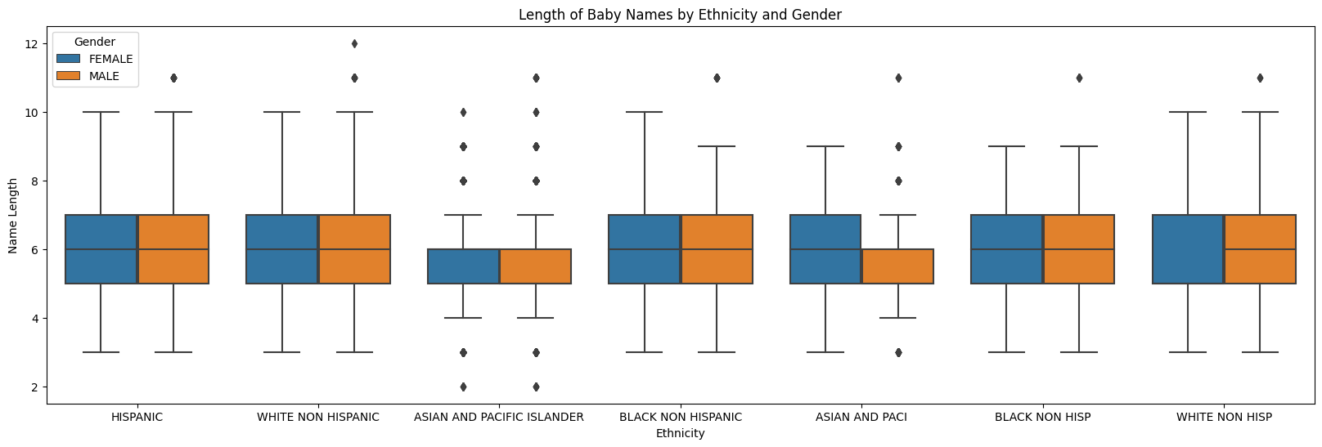

Figure 4: Baby Name Word Cloud by Ethnicity
Figure 4 showcases word clouds for the most popular baby names within each ethnic group. Each word cloud represents the top names for a specific ethnicity, with the size of each name corresponding to its frequency within that ethnic group. These visualizations provide insights into the unique naming preferences and cultural influences across various ethnicities, emphasizing the diversity of baby names in the United States.

Slide 10
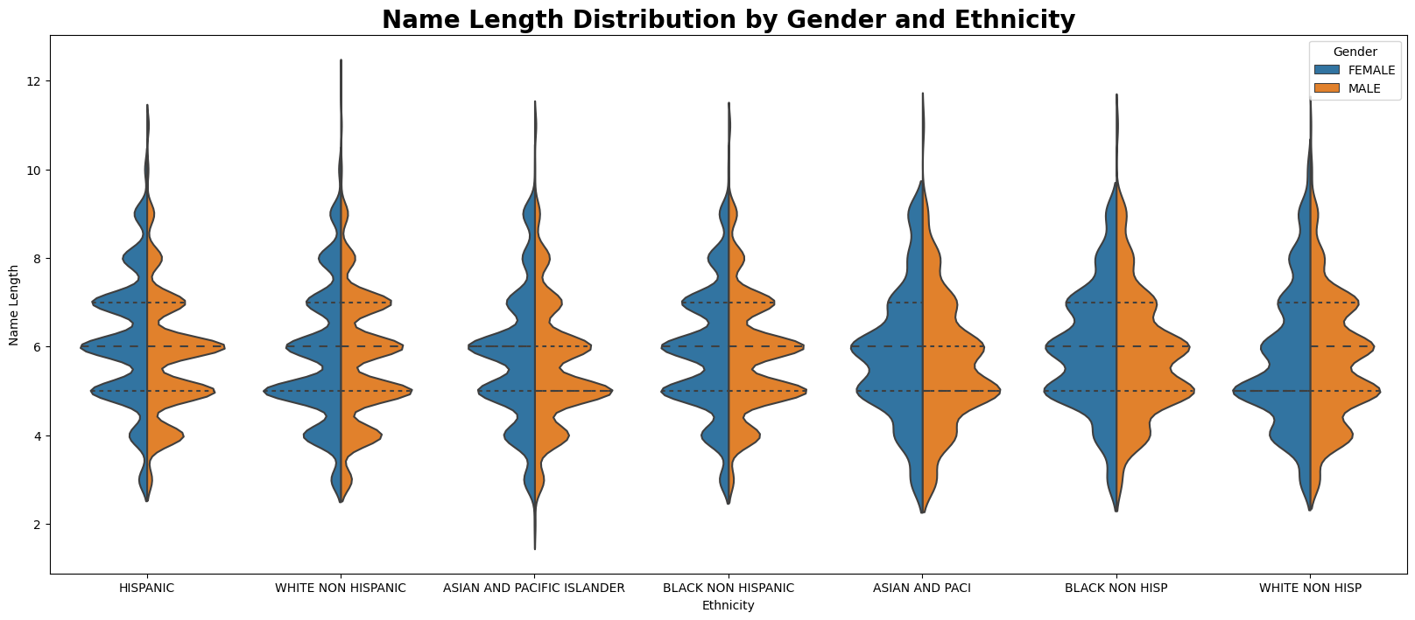
Figure 5: Name Length Violin Plot
The violin plot in Figure 5 shows the distribution of baby name lengths for different genders and ethnicities. Each violin represents the density of name lengths for a specific gender and ethnicity, with the width of the violin indicating the number of names with a particular length. This plot provides insights into how name lengths differ across various demographic groups, revealing the influence of different languages and cultural backgrounds on naming practices.

Slide 11
Machine Learning Application
1. Data Preprocessing:
- Imported necessary libraries and read the dataset
- Converted columns to the correct data types
2. Data Visualization:
- Word clouds for all names and top names per ethnicity
- Line charts for popular baby name trends by gender and ethnicity
- Line chart for baby name diversity by gender
- Boxplot and violin plot for the length of baby names by ethnicity and gender
3. Cluster Analysis (KMeans):
- Grouped data by the baby's first name, and calculated the average length and total count for each name
- Standardized the features
- Applied KMeans clustering to identify naming patterns

Slide 12
Machine Learning Application
Why Machine Learning was used:
- To gain insights into trends and patterns of baby names based on gender, ethnicity, and length
- To identify cultural background and diversity in naming practices
- To cluster baby names based on their popularity and length for further analysis

Slide 13

Conclusions
Data
My analysis provides actionable insights and recommendations supported by direct evidence in the data:
1. The most popular baby names vary among different genders and ethnicities, reflecting cultural differences and societal trends. For example, names like "Moshe" and "Esther" are popular among White Non-Hispanic people, reflecting the influence of Jewish culture in that demographic.
2. Baby name diversity also varies across genders and ethnicities, revealing cultural influences on naming practices.

Slide 14
Conclusions
Data
3. The cultural background of baby names can be explored by analyzing the differences in name choices among different ethnicities, providing insights into the historical and cultural context of names. For instance, the popularity of names like "Muhammad" among Asian and Pacific Islander populations reflects the influence of Islamic culture within that community.
4. The length and syllable structure of baby names differ across genders and ethnicities, suggesting the influence of different languages and cultural backgrounds on naming practices. This can be seen in the differences between Hispanic names, which often have longer lengths and more syllables, compared to names from other ethnic groups.

Slide 15
Conclusions
In conclusion, my analysis of the "Popular Baby Names" dataset offers valuable insights into the cultural background and societal trends of baby names in the United States. These findings can contribute to a better understanding of American culture and social phenomena and provide useful guidance for future baby name choices. By exploring the popularity, diversity, and cultural origins of baby names, we can gain a deeper appreciation for the rich tapestry of cultures and traditions that shape naming practices in the United States.

Slide 16
Thank You!
Reporter: Refati Kuermayoufu

